Slide 1
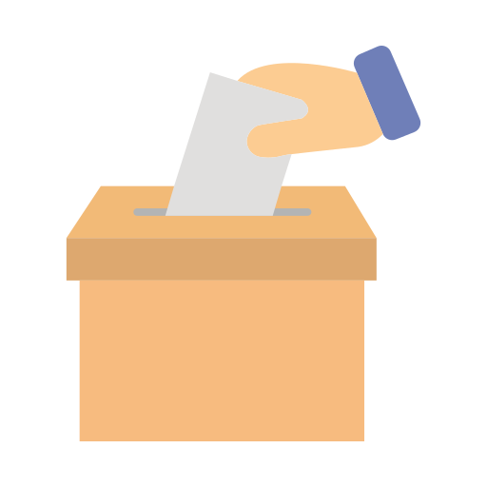
VoteChain
VoteChain
An e-voting system based on blockchain

Slide 2
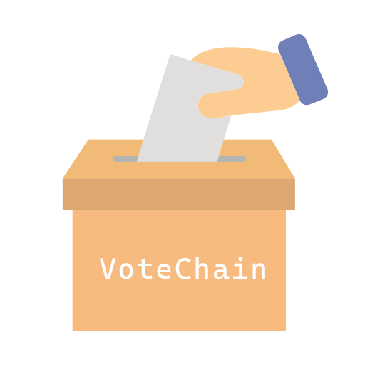



Contents
Introduction
Blockchain
VoteChain
Methodology

Slide 3
Introduction

Slide 4
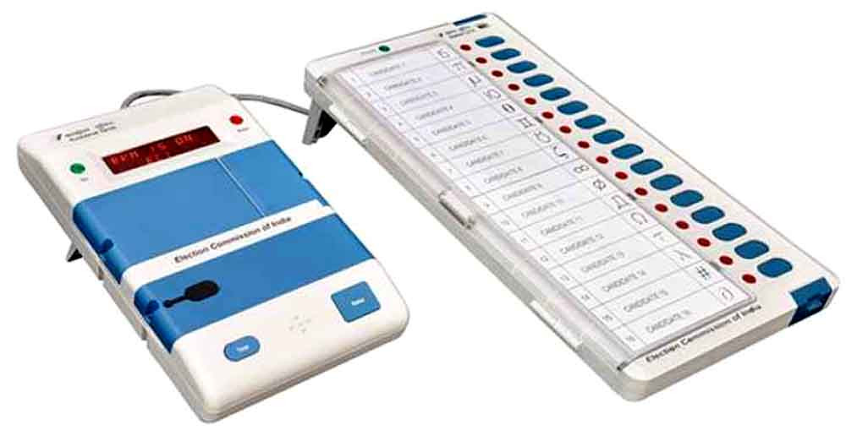
Modern democracies are built upon traditional ballot or electronic voting (evoting). In these recent years, devices which is known as EVMs are hugely criticized due to irregular reports of the election results.
There have been many questions regarding the design and internal architecture of these devices and how it might be susceptible to attacks.

Slide 5

Online-voting is pushed as a potential solution to attract the young citizens and the nonresident of the country. For a robust online election scheme, a number of functional and security requirements are to be met such as transparency, accuracy, auditability, data privacy, etc.

Slide 6
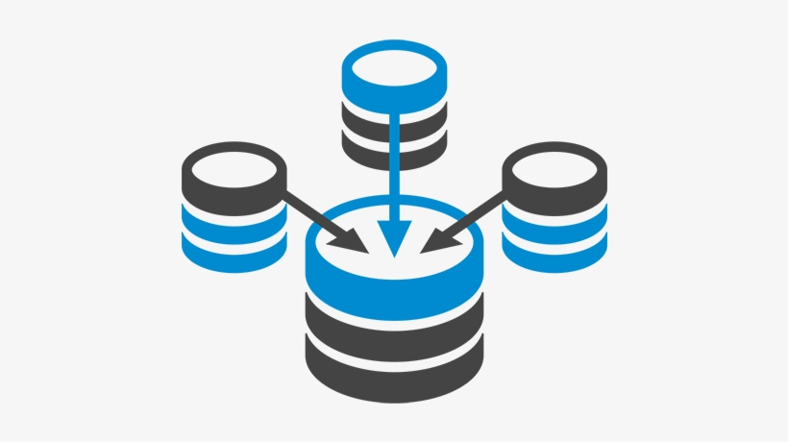
But if it is in Traditional Way
Lack of Transparency
Threat of Data Manipulation
Centralised Data Server

Slide 7

Blockchain
decentralized public ledger

Slide 8
About the Blockchain
Availability
Hard to Tamper
Transparency
Transition Traceability

Slide 9
Several studies have been done on using computer technologies to improve elections. These studies tell about the risks of adopting electronic voting system, because of the software challenges, insider threats, network vulnerabilities, and the challenges of auditing. We’ve proposed to design the existing online voting system which is integrated with the Blockchain technology.

Slide 10

VoteChain
VoteChain
+
E-Voting System
Blockchain

Slide 11
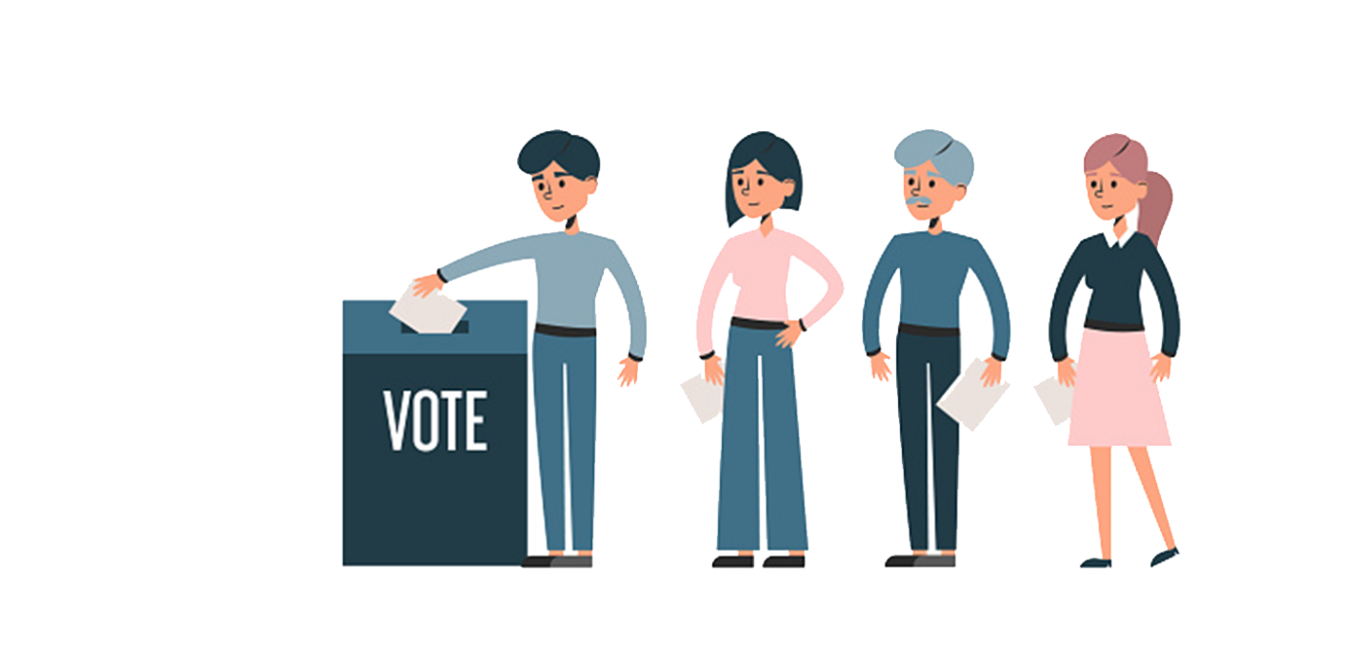
The proposed system has the following advantages as compared to the existing system
• Users’ can vote from anywhere in the world until he possess a citizenship of the country.
• The voting is stored in the Blockchain which makes it tamper proof.
• As there’s no standing in queue for casting vote it will save a lot of time and reduce the workload

Slide 12

Methodology

Slide 13


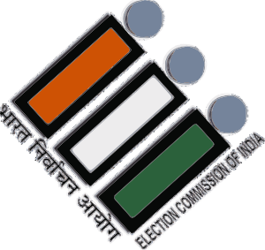

A country holds a election
A organisation is chosen to conduct election
creates code to insure
transparency and eliminate
vote fraud
Voting Tokens are issued to eligibles
People Start Voting
Every vote is recorded,
processed on the blockchain
with the results

Slide 14
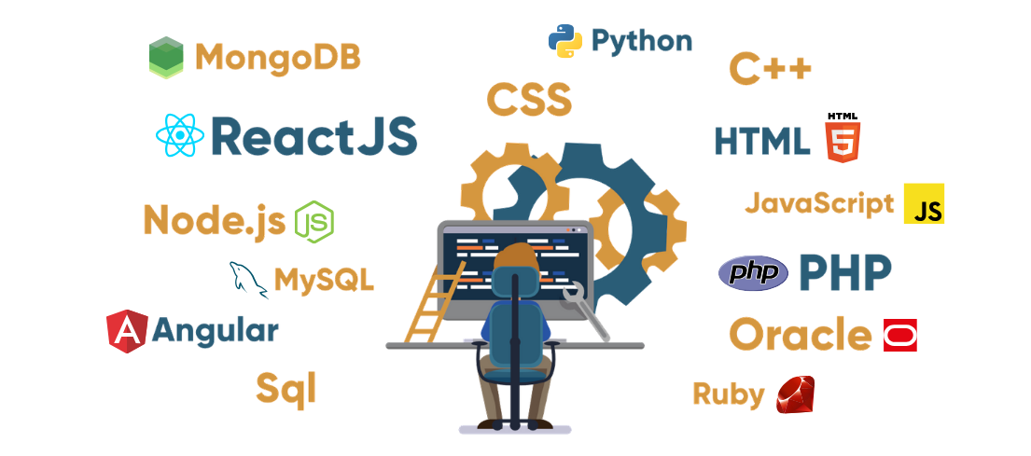
Tech Stack

Slide 15


Programming languages

Slide 16


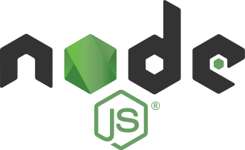

Code editor, runtime and frameworks

Slide 17

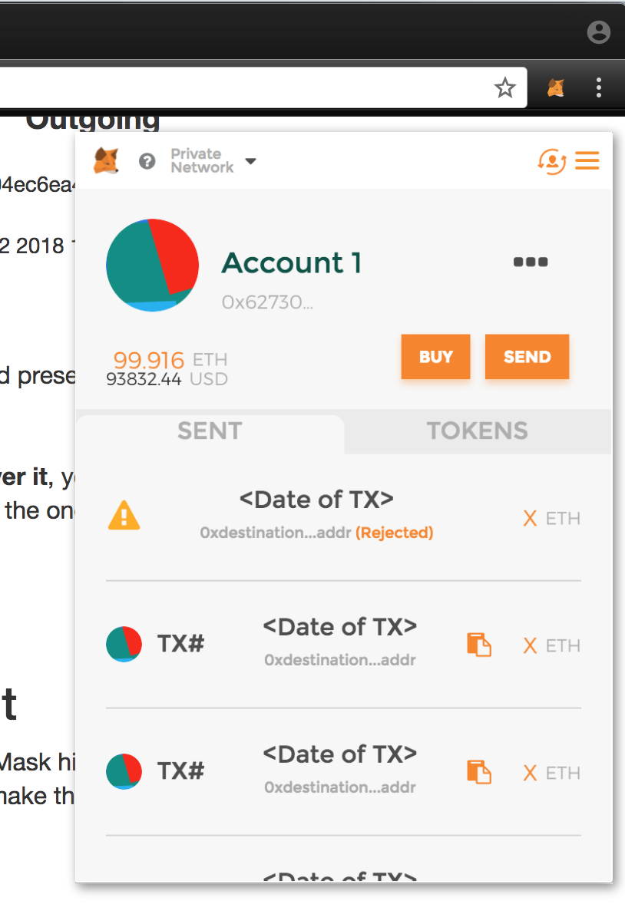

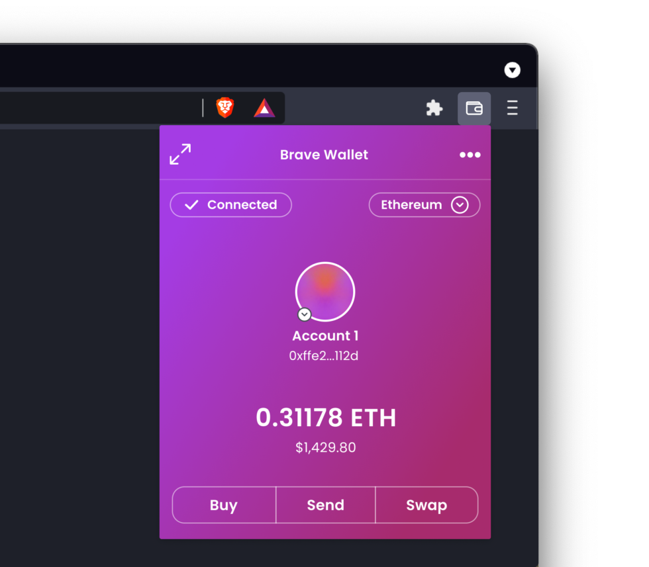
Crypto Wallet

Slide 18
VoteChain
Thank you.

